Slide 1
Diagnostic trouble code
DTC basic knowledge
Hien quach
8-5-2020

Slide 2
Agenda
All DTC status
Difference between GA and GB
Enhanced DTC Notifications
How to clear DTC

Slide 3
1. All DTC status
Short to positive voltage: gắn với nguồn
Short to ground chập dây

Slide 4
1. All DTC status

Slide 5
1. All DTC status
Code | DTCs | Status
U007B-00 (0xC07B – 0x00) | Control Module Communication CAN Bus 5 Off | HS disconnect
U0422-00 (0xC422 – 0x00) | Invalid Data Received from Body Control Module 1 Enabled (GEM Only) | When an incorrect signal comes to BCM
U0418-00 (0xC418 – 0x00) | Invalid Data Received from Brake System Control Module 1 (GEM Only) | When an incorrect signal comes
U0401-00 (0xC401 – 0x00) | Invalid Data Received from Engine Control Module Enabled (GEM Only) | When an incorrect signal comes
U0423-00 (0xC423 – 0x00) | Invalid Data Received from Instrument Panel Cluster (GEM Only) | When an incorrect signal comes
U0452-00 (0xC452 – 0x00) | Invalid Data Received from SDM | When an incorrect signal comes
U0402-00 (0xC402 – 0x00) | Invalid Data Received from Transmission Control Module Enabled (GEM Only) | When an incorrect signal comes
U1960-00 (0xD960 – 0x00) | Key Table Not Provisioned | MEC = 00
U1961-92 (0xD961 – 0x92) | Security Peripheral Performance – Performance or Incorrect Operation | Check the variable that stores the security peripheral error (dev test environment only)
U1962-00 (0xD962 – 0x00) | Unable To Authenticate Serial Data Message | Incorrectly sending the code value in MAC Message
U053B-00 (0xC53B – 0x00) | Invalid Data Received From EOCM 1 (GB Only) | When an incorrect signal comes
To check supported DTC, check at ALDL, GB DTC sheet

Slide 6


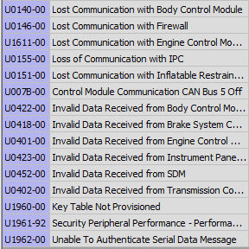
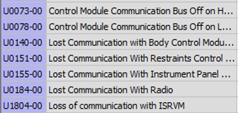
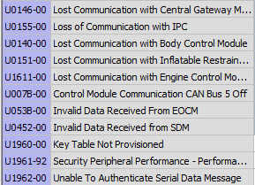
2. Difference between GA and GB
1. DTC Code, DTC Name
→ The DTC Code that differentiates the DTC has been changed.
→ Same DTC but DTC Name changed.
2. U-code DTC
→ Compared to the existing GA, U-code increase and occurrence
method are partially changed
GA U-code
GB U-code
GEM U-code

Slide 7
2.Difference between GA and GB/GEM
4. ATT – Reports & Module Info의 Current, History 표기법
→ History(2)
Unlike GA, in case of GB/GEM, history changes after going through VCP, TCP reboot or DRx.
(Check of 1Bit is canceled.)
Unlike GA, in the case of GB/GEM, history changes after going through VCP, TCP reboot or DRx.
(Check of 1Bit is canceled.)
< 1Bit의 의미 >
1Bit의 경우 Cycle을 의미하는 Bit로 현재의 Cycle에서 발생한 History인지 아닌지 Check.
Trong trường hợp 1 bit, đó là một bit có nghĩa là chu kỳ và kiểm tra xem nó có xảy ra trong chu kỳ hiện tại hay không.

Slide 8
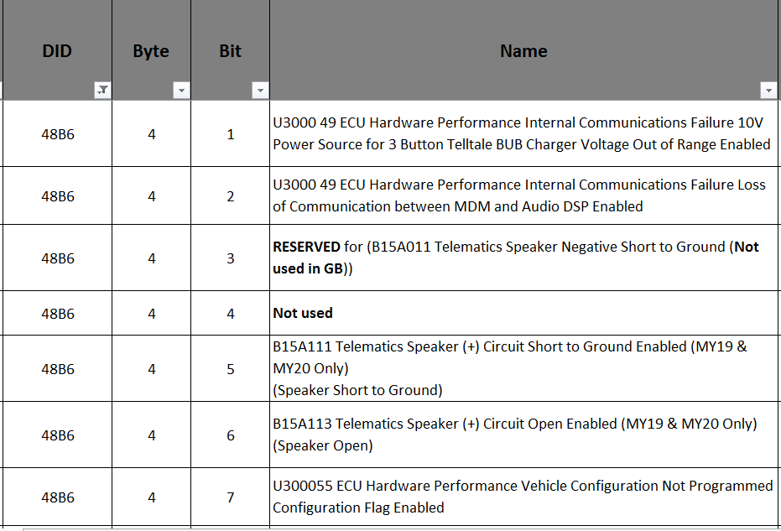
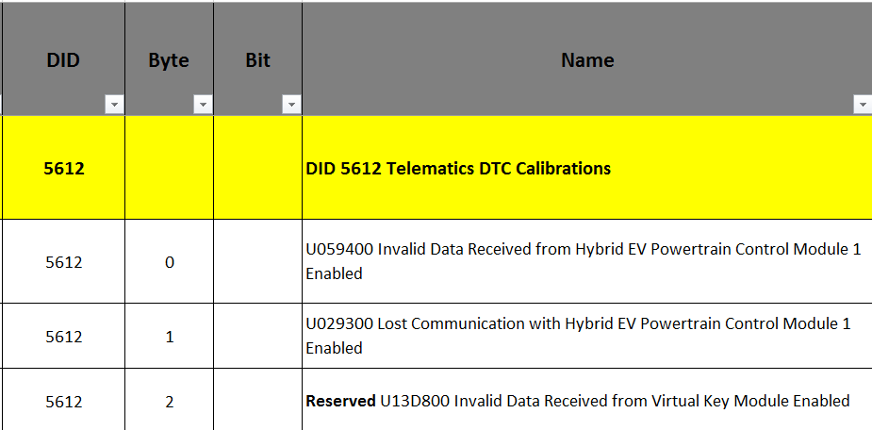
Validation Enable/ Disable DTC config flag
When false DTC will be disable => teltale green, not DTC indication
To config: check ALDL sheet DID, $48B6 fiter with DTC code. Beside, $5612
[0] FALSE [1] TRUE

Slide 9
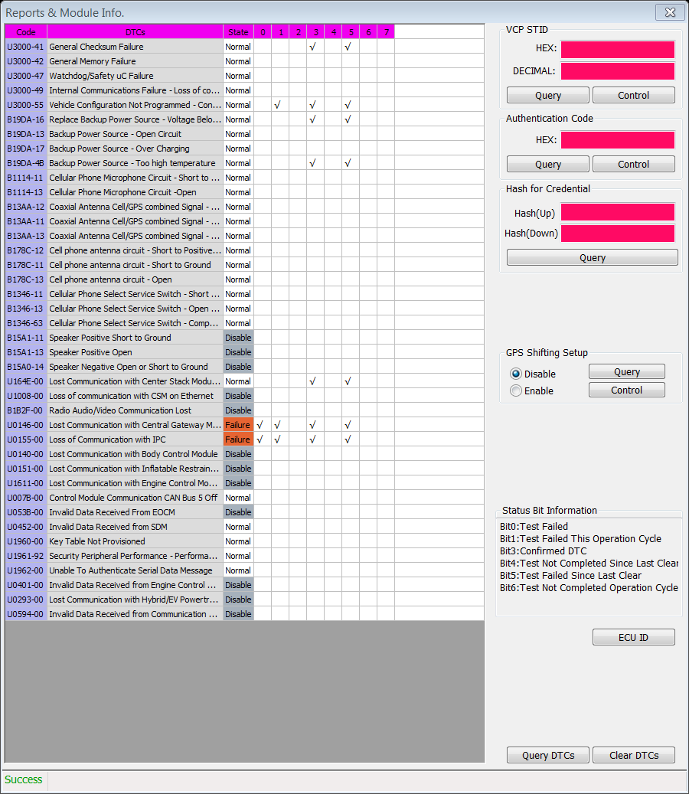
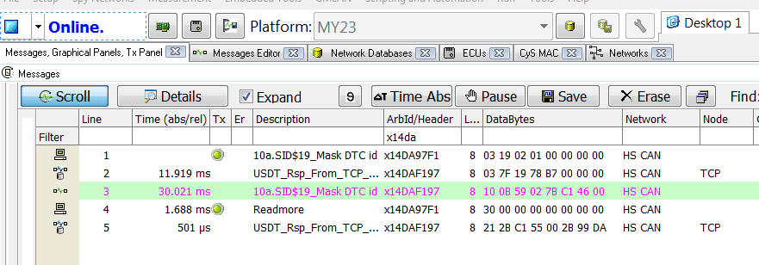
Read DTC
Code |  |  | DTC Name
U0146 | 0xC146 | 0x00 | Lost Communication with Central Gateway Module (GB)
U0155 | 0xC155 | 0x00 | Loss of Communication with IPC
Read current DTCs: 14DA97F1 03 19 02 01
Read history DTCs: 14DA97F1 03 19 02 02
Ex.2:
+ Request report DTC by SttMask=01
03 19 02 01
+ TCP responds successfully (USDT if several DTCs)
06 59 02 7B 93 46 13 2B

Slide 10
How to clear DTCs
Common way refer guideline document
\\10.218.140.56\vt1\05.Projects\GM GEN 11 TCP ST\8._HowToTest\Make DTC\GB\GM세미나__GB_GEM DTC_VCP_김동석.ppt
DTC U1008-00 Loss of Communication with CSM on Ethernet (GB) Set DID494E byte 0 =00 CSM
DTC U164E-00 send VAS simulation signal
U3000-55 set DID45E2 byte 0 = 03

Slide 11
Enhanced DTC Notifications Emergency Response System Type Flow
System shall transmit the Emergency Response System Service Indication On signal with the value of True If one or more of the following DTCs are currently set
U3000-41/42/47/49 General/Internal Failure/Watchdog B19DA-16 Replace Backup Power Source - Voltage Below Threshold B19DA-4B Backup Power Source – Too high temperature B13AA Coaxial Antenna Cell/GPS combined Signal B178C Cell phone antenna circuit B1346 Cellular Phone Select Service Switch U0151-00 Lost Communication with Inflatable Restraint Sensing and Diagnostic Module
56B: EmerResSystemType (536) 4E6: Byte 3 bit 2-Emergency Response System Service Indication On (53A)

Slide 12
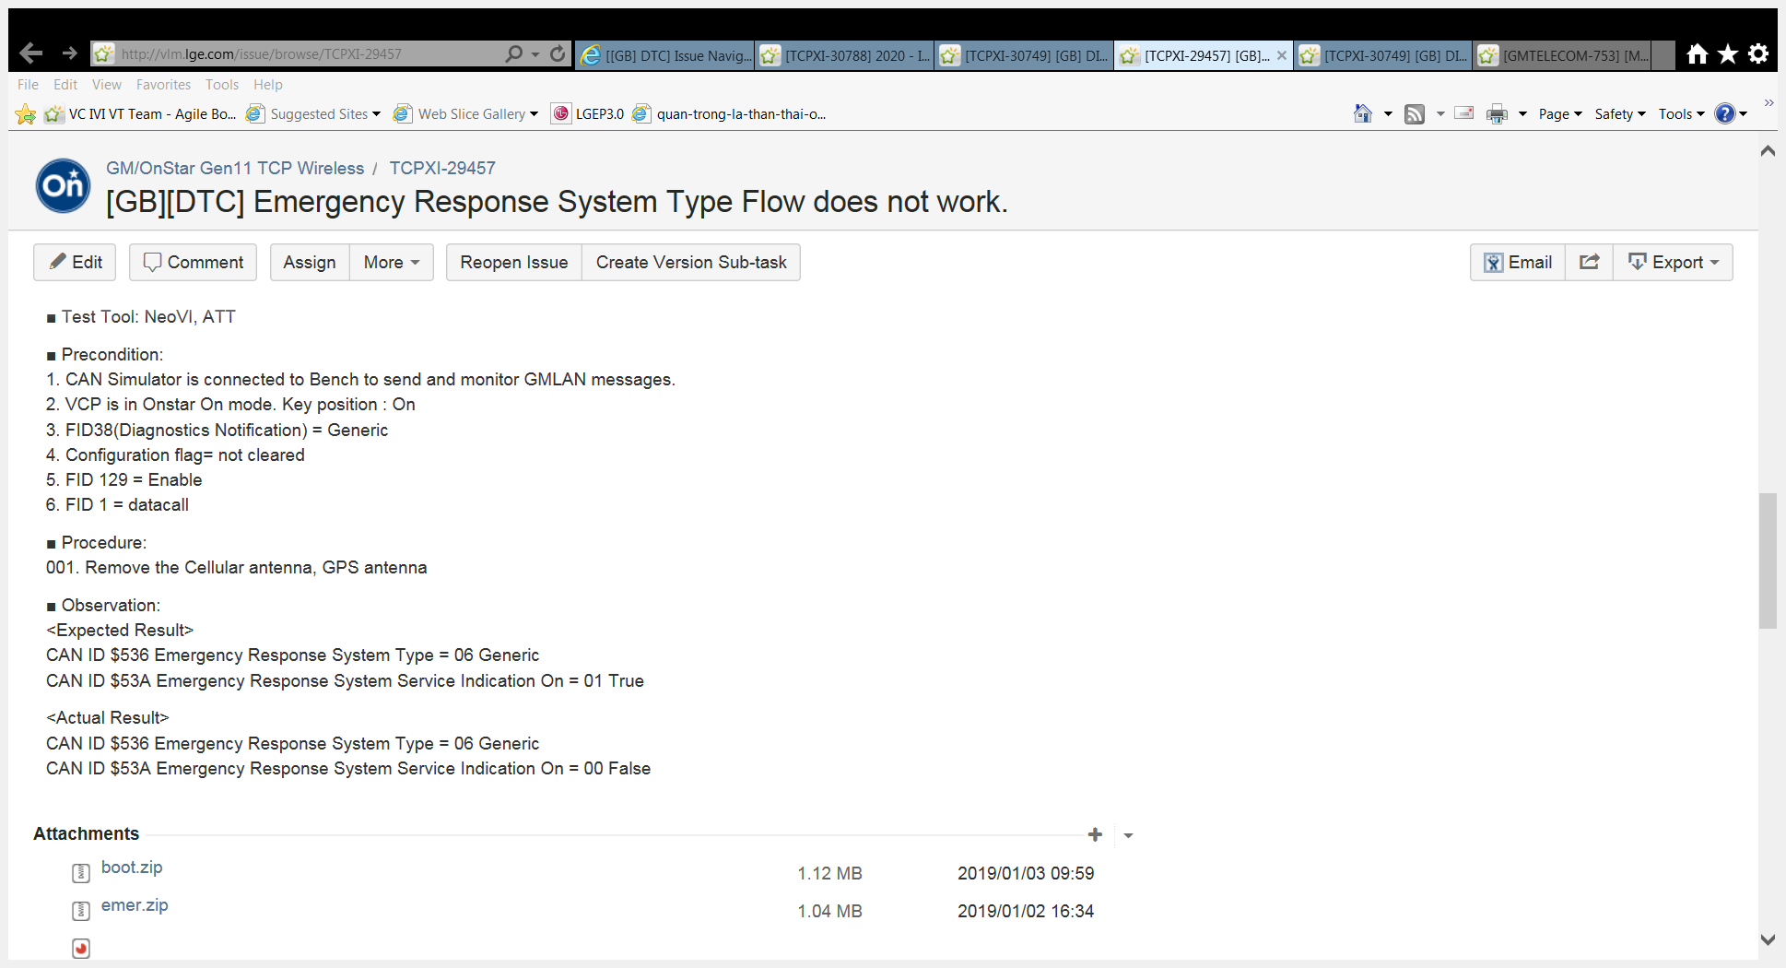
Enhanced DTC Notifications
Emergency Response System Service Indication On = 01 True when some DTC occurs
TCPXI-39473 In the ECP description, it should be applied both GA and GB. However, above DTC lists are only for GA, and there is no GB DTC List. So, LGE was not fully implemented GB DTC list for this ECP.

Slide 13
TCPXI-25798 DTC trigger message
■ Precondition: 1. TCP is On. 2. B13AA-13 DTC set to current.
■ Procedure: 1. Go to DRx mode and ignition key on. 2. Observe the DTC Triggered message ($533).
■ Observation: <Expected Result> DTC Triggered message is not transmitted.
<Actual Result> DTC Triggered message is transmitted.
(My23) $549
$549 only store last status => Drx to ON => Clear all value and not give current value until remake DTCs

Slide 14
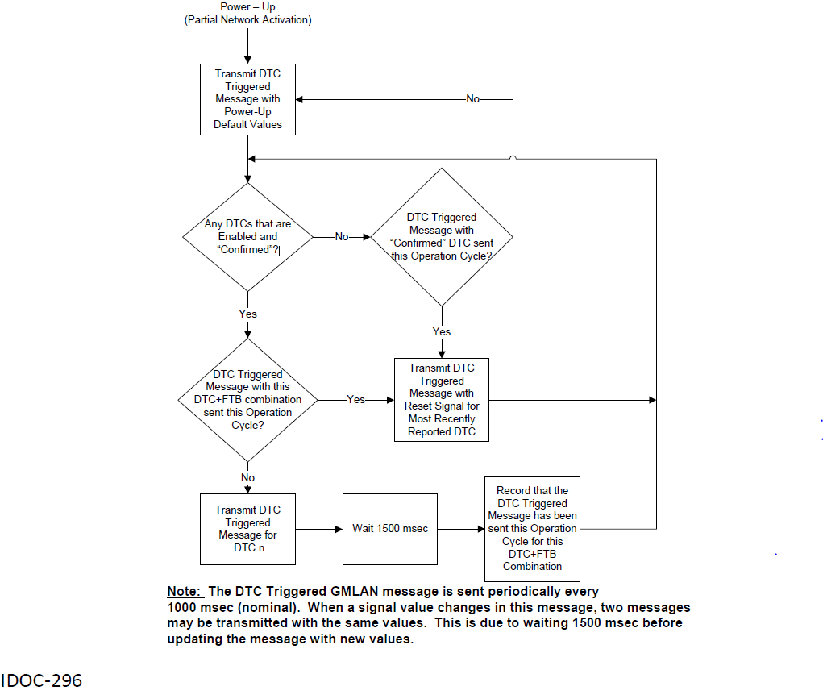

Slide 15
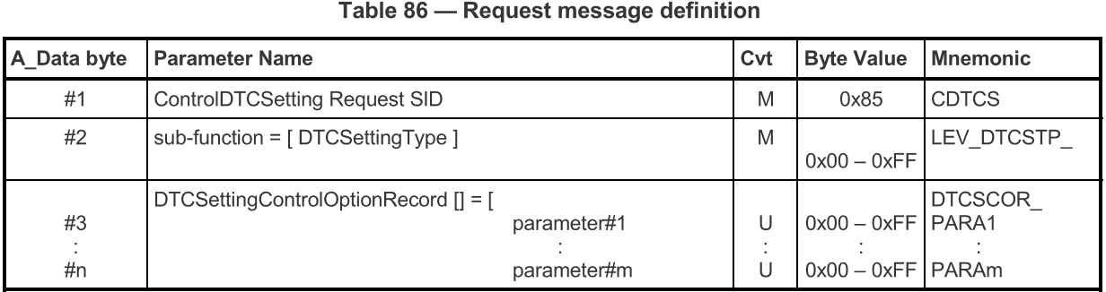
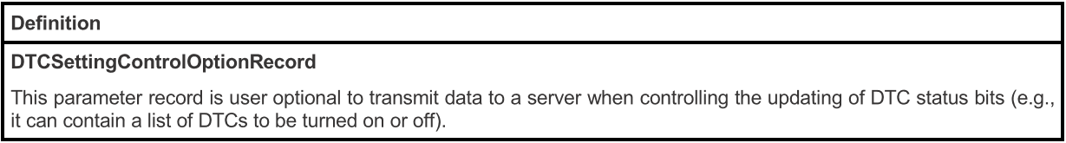
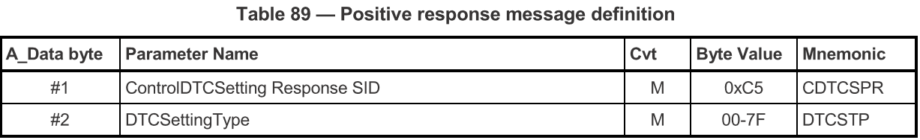
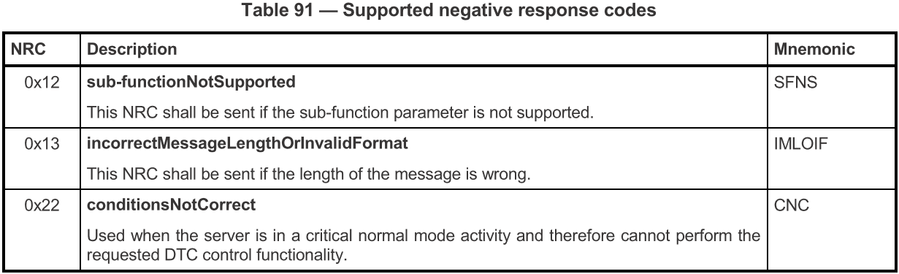
Service$85- ControlDTCSetting service
The ControlDTCSetting service shall be used by a client to stop or resume the updating of DTC status bits in the server(s).
DTC status bits are reported in the statusOfDTC parameter of the positive response to certain sub-functions of ReadDTCInformation
Service$85 processes in Extended session
Support + NRC $7F
Ex.1:
+ Send DTC Control Type ~- Off
02 85 02
+ TCP responds
02 C5 02
No DTC report (03 59 02 7B)
Ex.2:
+ Send DTC Control Type ~- On
02 85 01
+ TCP responds
02 C5 01
=> DTC report normally (07 59 02 7B XX XX XX 2B)
Sub-function $02: Control type ~-Off
Success response
Sub-function $01: Control type ~-On

Slide 16
The End

Slide 18
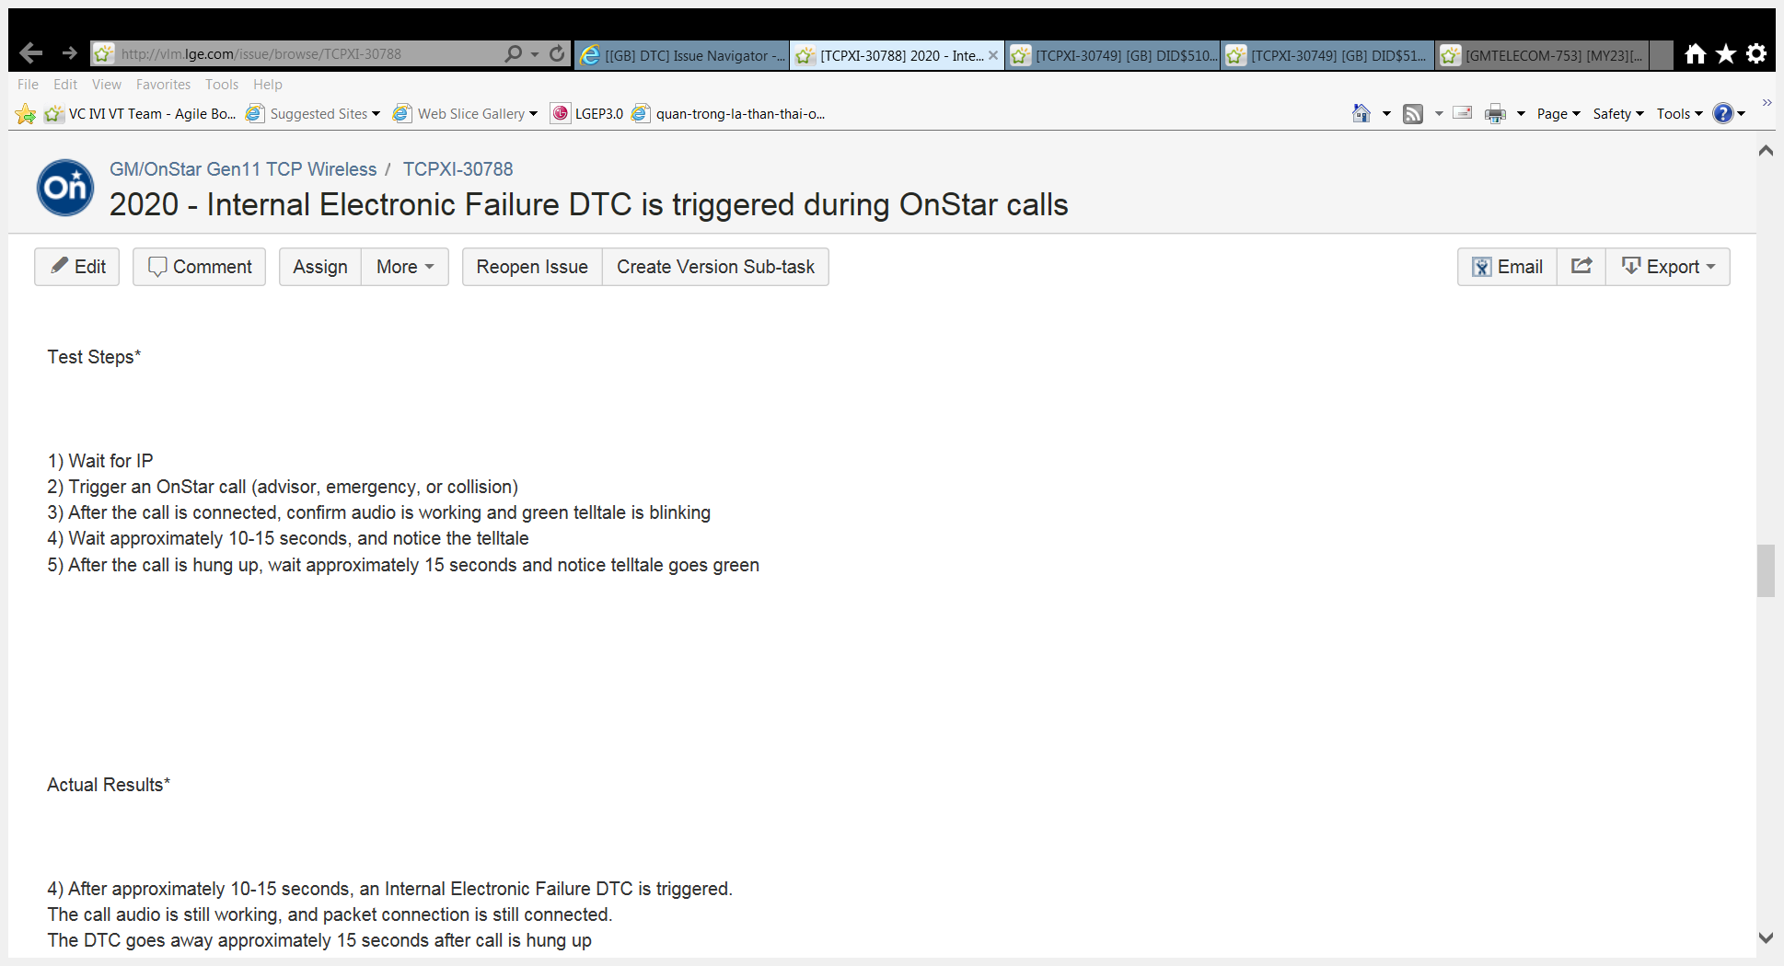
Defect analysis

Slide 19
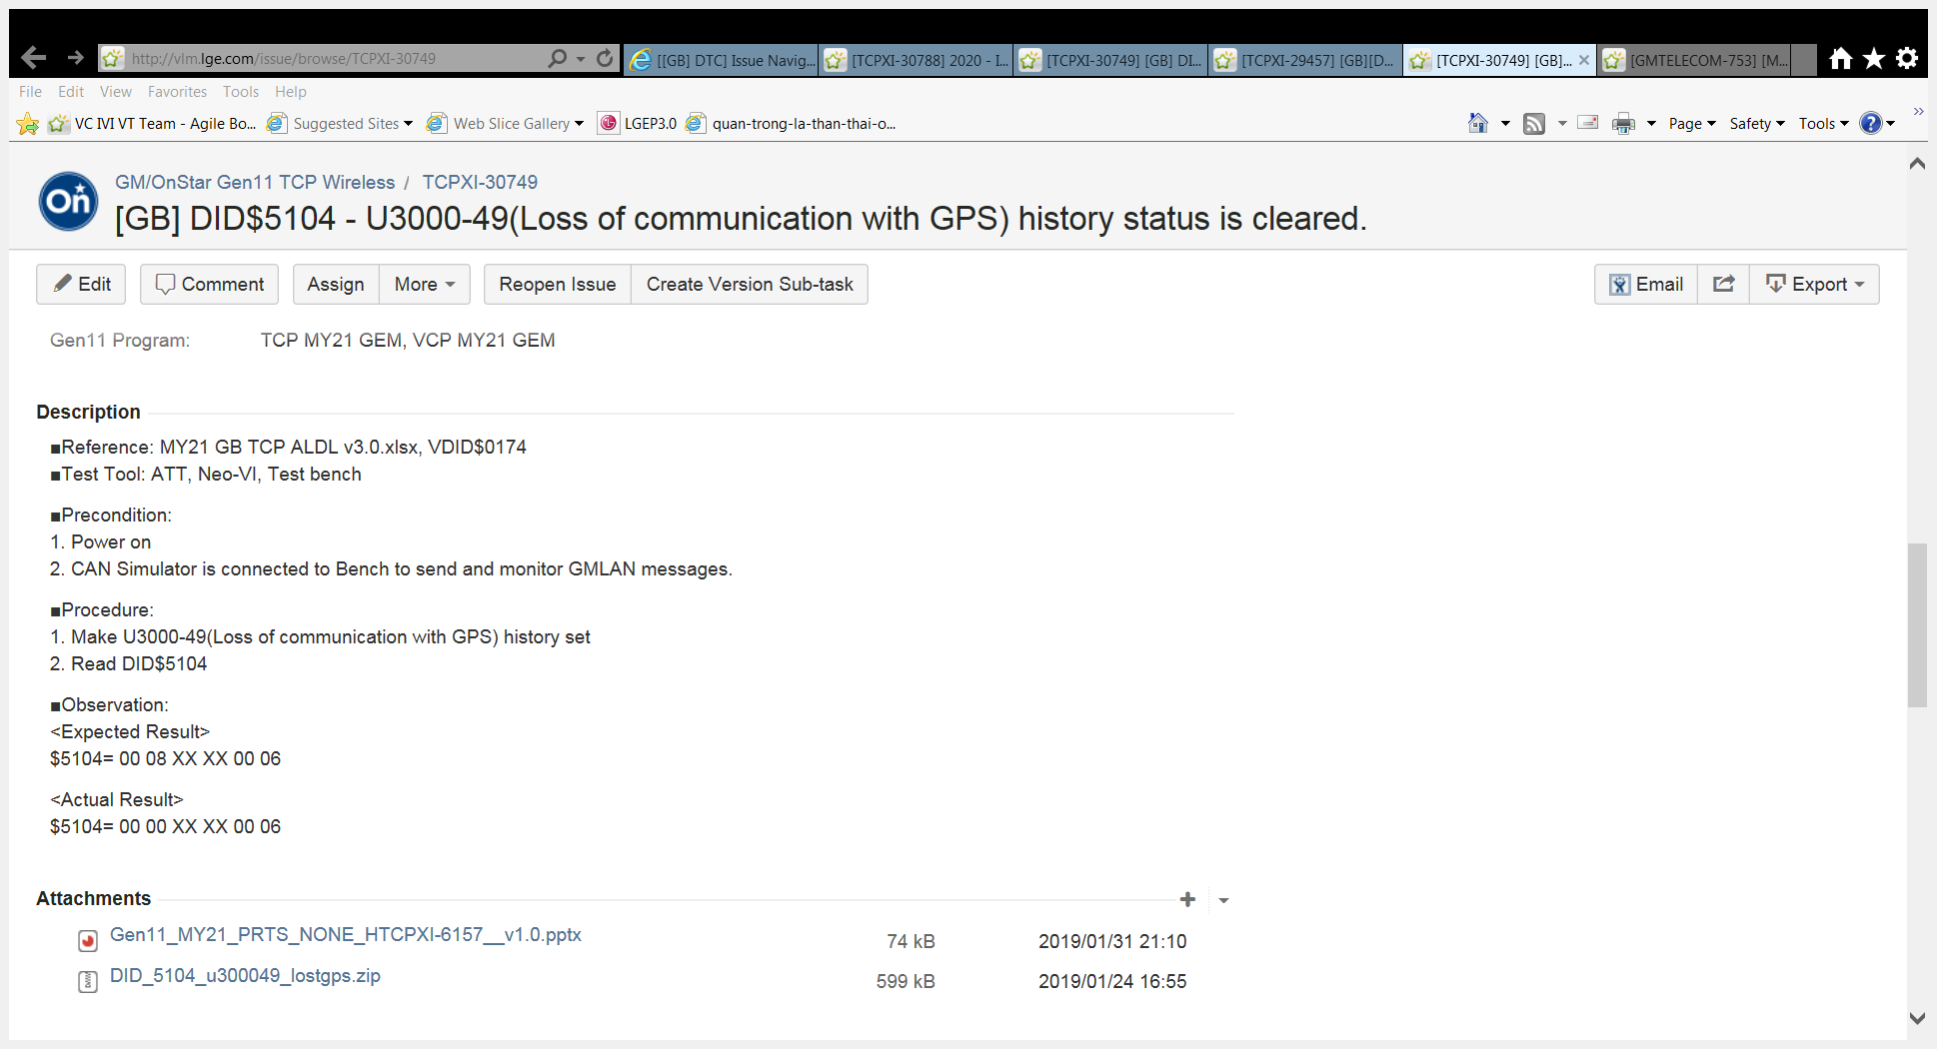
Defect analysis
Check DID5104 in ALDL , support some DTC, when DTC check, value of DID 5104 change with mapping value

